Slide 1
WHAT IS DATA MINING?

Slide 2
What is Data Mining?
Extracting knowledge from large amount of data
- cleaning: values that we get from user might not be meeting the standard set by the data owner.
For ex: age or job experience. It should be in years. What if you find 28.5 or 39.2 like values in the data? In Python, you would write some code like this: round(age)
Date formatting: it could be like 15-02-2023, or it could be like: 2023-06-09, or it could be like: Wednesday, June 7, 2023, numerous date formats are available, but machine needs a consistent format.
If the machine cannot understand the data, it cannot learn. Hence, data cleaning is required.
- integration: Let’s say sender system is sending some string type of data. At the receiving end, you need integer, what do we do? Answer is: Type casting.
If the two systems are supposed to talk, then there should exist a protocol or a language that both systems understand. For example: in JavaScript we have ‘true’ and ‘false’. While in Python, we have ‘True’ and ‘False’. It is a difference of capitalization, but it is big difference from integration point of view if this data is to be passed around. If we need to zero down on a common standard, values like 0 and 1 could also help.
- selection: You have some data that’s about the bio of a person. So maybe as a data scientist you want to explore relationship between height and weight. Or maybe between age and fat%.
In such a situation, you would have to select only the required columns from the tabular data.

Slide 3
- transformation:
type casting is again an example of transformation.
Another example could be transforming data to fit it to a scale of 0 to 1 (as in Min Max Scaling)
You want to plot the data in logarithmic scale (base could be 2, 10 or e=2.718) at that point you would be doing a transformation.
Logarithmic transformation required to convert exponential curve to linear curve.
- mining/processing:
* studying the data to get it’s descriptive statistics
* study the correlation, similarity, dissimilarity and / or distance
* to know more about it’s features and attributes.
- pattern evaluation:
In stock market analysis: Have you heard of bearish market and bullish market?
Those are two kinds of patterns or trends in the market. There also exists a third type of trend which is ‘stagnation’.
It is the job of market analysts to capture these trends.
Another example could be of CPU usage. During normal processing, CPU usage would fluctuate around the mean. But when some large file is loaded or big data is loaded, CPU usage and memory usage might start to increase.
- presentation: drawing a scatter plot to see correlation, or drawing a line plot to see growth or decline, drawing a pie chart to show percentage composition of a composite category.

Slide 4
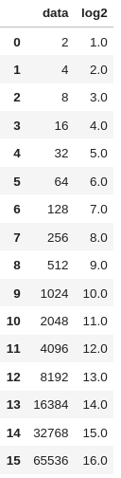
# Transformation of data: from exponential scale to linear scale using logarithms

Slide 5
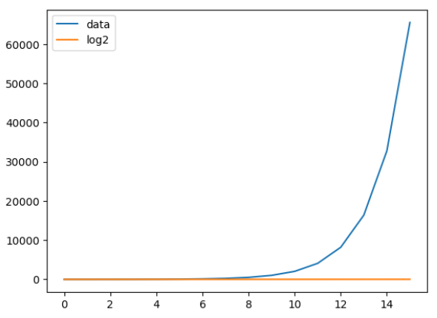
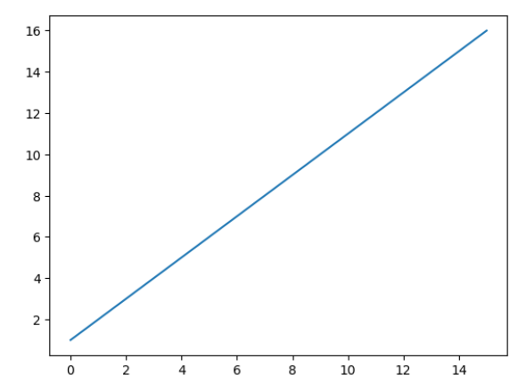
Data and Log of Data on same plot
Log (base 2) of Data

Slide 6
>>> age = float(input("Enter your age: "))
Enter your age: 28.5
>>> age
28.5
>>> age = round(age)
>>> age
28
>>> yob = input('Enter your yob: ')
Enter your yob: 2003
>>> type(yob)
<class 'str'>
>>>
>>> int(yob)
2003
>>>

Slide 7
What kind of patterns can be mined/found by data mining techniques?
Characterization and Discrimination:
Studying the properties of the given data. Laying down the lines for character identification of something from the data.
Frequent patterns, Associations, and Correlations
In a healthcare shop, you might notice that skin care soap goes along with skin care cream / night cream or sun screen cream.
Classification
As in image classification, cat versus dog. Or in medical science, differentiating between malignant tumor and benign tumor.
Prediction:
- monitoring of seismic waves to predict earthquake
- breakdown point of a circuit that is temperature sensitive
Cluster analysis: The task is to identify: (1) the number of clusters and
(2) grouping the data points that make up those clusters.
Outlier analysis: what is happening (abnormally) in the extreme ends of the data?
You have credit card transaction. You want to predict a fraudulent transaction. Every transaction has some features like: amount, place, mode of approval (touchless or via PIN)
Evolution analysis

Slide 8
Give examples of each of the following:
Characterization
  Characteristics of customers who buy a certain kind of product
  Maybe some person who only buys from FOSS (Free and Open Source Software) community.
  Maybe some person who only Apple products.
Discrimination
  Customers who buy product A vs customers who buy another product B

Slide 9
Give examples of each of the following:
Frequent patterns, Associations, and Correlations
  What kind of products do customers buy together?
  If customer buys product A, what’s the chance that he/she will buy product B as well

Slide 10
Give examples of each of the following:
Classification
  You have get dataset containing images of animals. A task of classification would be to tell if it’s a cat image or not.
  This is a Cat and ‘Not Cat’ Image Classification problem.
Prediction
  Sales Forecasting: Predict the sales of the product
  House price prediction based on number of rooms that are there, area, number of balcony and bathroom, etc.

Slide 11
Give examples of each of the following:
Cluster analysis
  Divide the data into different groups of similar items
  No. of cluster are not known apriori
  Example: During Covid-19, we clustered the population into color coded regions. Red zone areas, orange zone and green zone etc.
  Features:
  Number of infections
  Population density
  Severity of cases
  So and so forth

Slide 12
Give examples of each of the following:
Outlier analysis
  Deviant data from the expected
  Centenary population: people who live past the age of 100. They are like outliers.

Slide 13
Give examples of each of the following:
Evolution analysis
  Time series analysis of data

Slide 14
# Getting all male customers.
SQL> Select * from customers where gender = ‘M’;

Slide 15

A customer’s data could look like:
1. Operational expense data
2. Categories / Departments in which person makes purchases.
Threshold is set at: 5K INR in a month for grocery (viz. Department) to identify the customer as profitable in that department.
It could be 10K INR for home appliances and 2K INR for dairy products (just an example).
Setting this threshold is a problem of prediction (Data Mining).
Only requires writing a SQL query now.
Broad steps: aggregating and filtering if the threshold is given.

Slide 16
Let’s say you want: 3 on the throw of a dice.
Size of sample space = {1, 2, 3, 4, 5, 6} = 6
P(event = 3) = 1 / 6

Slide 17
Stock Market Analysis (or Prediction)

Slide 18
